Slide 1
PREDICTING ACCIDENT SEVERITY IN SEATTLE
USING MACHINE LEARNING ALOGRITHM

Slide 2
BACKGROUND
More than 10,000 crashes per year in Seattle
Average 20 people losing their lives
Over 150 people suffering life-changing injuries

Slide 3
PROBLEM STATEMENT
In order to eliminate accident fatalities in Seattle, Seattle need to
To predict the severity of accidents
To identify the primary risk drivers affecting severity of accidents
Take actions to reduce the impact
Hence, accident severity model is build using machine learning model

Slide 4
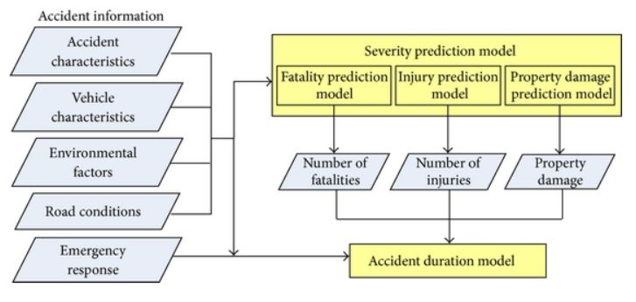
ACCIDENT FRAMEWORK

Slide 5
SEATTLE’S ACCIDENT DATA
From Seattle’s accident data, which includes all collision types from year 2003 until now, the potential variables are listed below.
Attribute | Description
ADDRTYPE | Collision address type
COLLISIONTYPE | Collision type
JUNCTIONTYPE | Category of junction at which collision took place
INATTENTIONIND | Whether or not collision was due to inattention
UNDERINFL | Whether or not a driver involved was under influence of drugs or alcohol
WEATHER | Weather conditions during the time of collision
ROADCOND | The condition of the road during the collision
LIGHTCOND | The light conditions during the collision
PEDROWNOTGRNT | Whether or not the pedestrian right of way was not granted
SPEEDING | Speeding
HITPARKEDCAR | Whether of not the collision involved hitting a parked car
WEEKEND | Derived. To indicate weekend variables
STRUCKING VEH | To derive the strucking vehicle

Slide 6
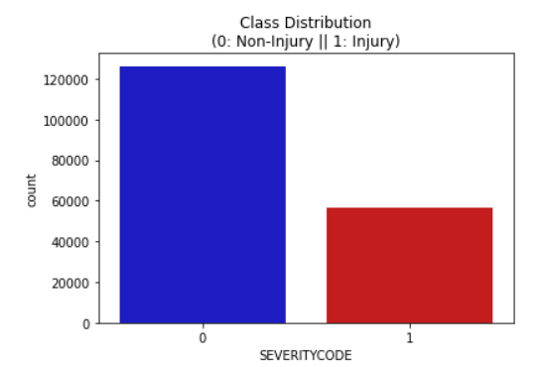
OVERSAMPLING
There are 56,625 (30.96% of total) injury cases. Oversampling technique is employed to produce reliable result.

Slide 7

MODEL
Logistic regression is chosen due to its high discriminant power, simplicity and interpretability.

Slide 8
DISCUSSION
Apart from accident characteristics, primary risk drivers are:
Snowing/ Snowing road conditions
Driver under influence of drugs or alcohol
Speeding

Slide 9
REMEDIES
Use de-icer to combat ice and snow.
Establish weather forecast platform to remind drivers slow down
Stiffer penalty and longer jail term for those speeding and driving under influence of drugs and alcohol

